Slide 1


Composite Pattern
Structural, Object focused

Slide 2
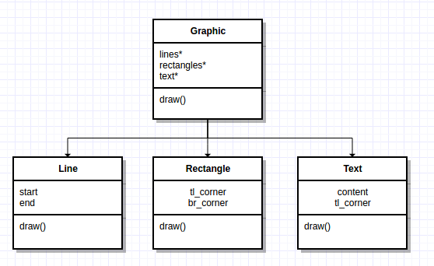
Motivation
Often we want to represent both simple and complex hierarchies uniformly. For example, graphics programs allow users to build complex diagrams out of simple primitive components. Imagine the following implementation:
Primitives (line, rectangle, text) each have their own class
More complex graphics are composed of those primitives or other graphics (compositions)
Primitives and compositions are different classes

Slide 3
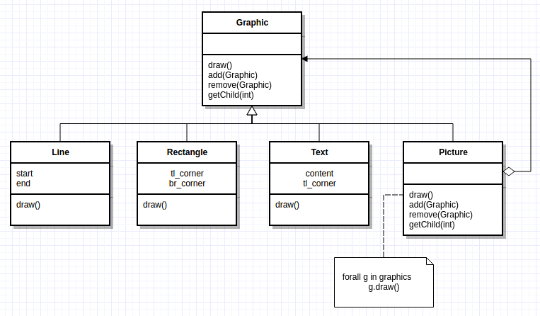
Motivation
Clients typically treat primitives and compositions the same. Notice the “draw()” function in each class

Slide 4
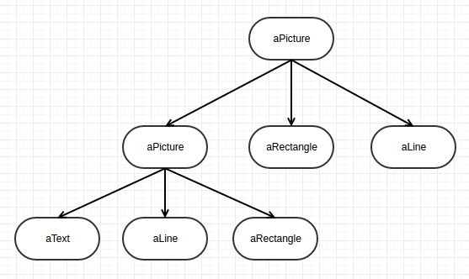
Motivation
We need to create a hierarchy of objects using recursively composed Graphic objects

Slide 5
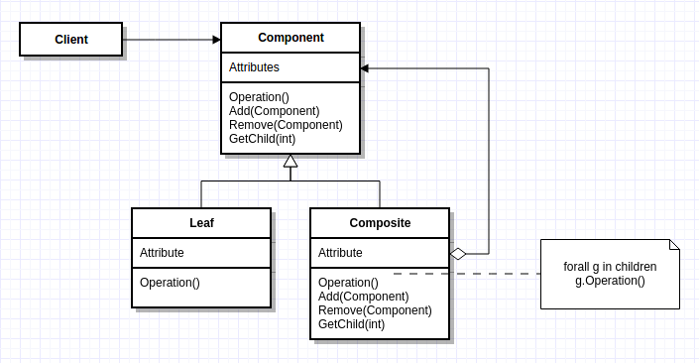
Structure
Component
Declares the interface
Default behavior
Leaf
Behavior of primitives
Composite
Stores children
Implements child related operations
Client
Manipulates composition through interface

Slide 6
Consequences
Pros:
Defines class hierarchies consisting of primitive and composite objects
Primitive objects can be composed into more complex objects (composites)
Makes client interaction simple. Clients treat composites and primitive the same, using the same interface
Adding additional components (primitives/composites) is straightforward
Cons:
Design is overly general
Harder to restrict components of a composite
Is not strictly SOLID (more on that later in the course)

Slide 7
Example from “Design Patterns: Elements of Reusable Object-Oriented Software”
Erich Gamma
Richard Helm
Ralph Johnson
John Vlissides

Slide 8
Designing A Document Editor
We are designing a “What-You-See-Is-What-You-Get” (or “WYSIWYG”) document editor called Lexi. The document editor can
Mix text and graphics freely
Utilize a variety of formatting styles
Surrounding the document are
Pull-down menus
Scroll bars
Icons

Slide 9
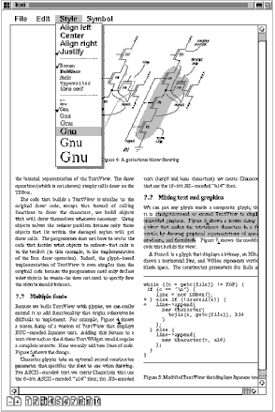

Slide 10
Design Problems
The initial design problems for Lexi can be summarized as 7:
Document structure
Formatting
Embellishing the user interface
Supporting multiple look-and-feel standards
Supporting multiple window systems
User operations
Spelling checking and hyphenation

Slide 11
Document Structure
This refers to the internal representation for the document which will influence every aspect of Lexi’s design. Such representation needs to:
Maintain the physical structure (the arrangement of everything visible and invisible on the document)
Generate and present the document on the GUI
Map positions on the display to elements of the representation (e.g., columns and rows)
Treat text and graphics uniformly

Slide 12
Recursive Composition
Used to represent hierarchically structured information
Increasingly complex elements are built out of simpler ones
Sets of characters and graphics can be tiled into rows, and groups of rows in columns, and groups of columns in pages, etc.

Slide 13
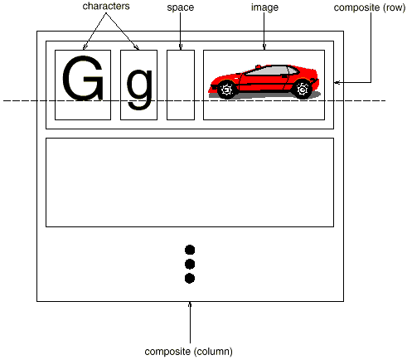
Example
Let’s tile characters and graphics form left to right to form a line within the document
The multiple lines can be grouped together to form a column
Multiple columns make for a page

Slide 14
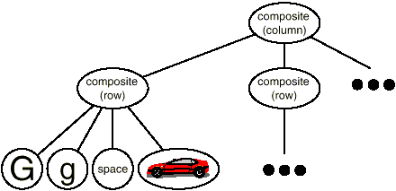
Example
We can represent the recursive composition using a hierarchy
Each object in the lower level are contained by the object in the level above it (columns have row, rows have characters, graphics, etc.)
What does this look like?, how can we relate these classes to each other?

Slide 15

Inheritance

Slide 16
Going back to the Composite Pattern
Which classes qualify as a leaf class?
Which are composite?
Which class would you choose as a component?

Slide 17
Glyph
We start with an abstract base class for all objects that can appear in a document structure called Glyph
Its subclasses define both base and structural elements
What common interface(s) make sense for all these objects to share?

Slide 18
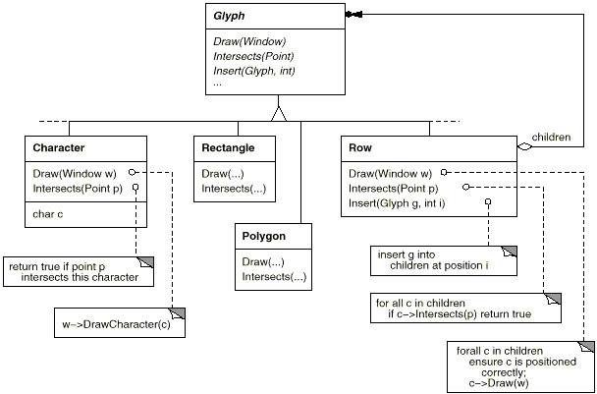

Slide 19
Glyph
Glyphs have three basic responsibilities
They know how to draw themselves
They know what space they occupy
They know their children and parent

Slide 20
Responsibility | Operations
appearance | virtual void Draw(Window*)
 | virtual void Bounds(Rect&)
hit detection | virtual bool Intersects(const Point&)
structure | virtual void Insert(Glyph*, int)
 | virtual void Remove(Glyph*)
 | virtual Glyph* Child(int)
 | virtual Glyph* Parent()

Slide 21


Inheriting from Glyph
Each Glyph subclass will redefine the draw operation to render themselves onto a Window
A Rectangle subclass of Glyph might redefine draw like this
void Rectangle::draw(Window* w) {
drawRect(w->x + this->ul.x, w->y + this->ul.y,
w->x + this->lr.x, w->y + this->lr.y);
// The window is an offset point for the rectangle
}

Slide 22
Bounds()
A parent Glyph knows how much space a child glyph occupies
The Bounds operation returns the rectangular area that the glyph occupies
void Rectangle::bounds(Rectangle& r) {
r->ul = this->ul;
r->lr = this->lr;
// Since we are already drawing a rectangle, return
// the internal attributes as the bounds
}

Slide 23
Intersects( )
The Intersects operation returns true if a specified point intersects a specific glyph
The Rectangle class redefines this operation to compute the intersection of the rectangle at the given point
bool Rectangle::intersects(Point& p) {
if(p->x > this->loc.x + this->ul.x &&
p->x < this->loc.x + this->lr.x && ...) {
return true;
} else { return false; }
}

Slide 24
Other operations
The Insert operation inserts a glyph at a position specified by an integer index
The Remove operation removes a specified glyph if it is indeed a child
The Child operation returns the child (if any) at the given index, and glyphs with children should use Child internally instead of accessing the child data structure directly so we don’t have to refactor the class when internal data structures change (such as going from an array to linked list)
The Parent is like Child but provides the same type of interface to the parent

Slide 25

Summary
The Composite Design Pattern is used to treat simple (leaf) and complex (composite) elements uniformly
All components inherit from a base Component class that defines a common interface
Complex elements may contain simple ones or other complex elements as well
Recursive Composition is a common was to represent the hierarchy of the structure
The implementation of the Composite Pattern should be independent and flexible to the way components are iterated through

Slide 26
Back to the Design Problems
Document structure: Composite Design Pattern
Formatting : ?
Embellishing the user interface: ?
Supporting multiple look-and-feel standards: ?
Supporting multiple window systems: ?
User operations: ?
Spelling checking and hyphenation: ?

Slide 27

Questions?

